Slide 1

Master’s Thesis Initial Topic Presentation
Monocular 3D Traffic Perception Using HD Maps as an Auxiliary Feature
Joseph Birkner
Chair of Robotics, Artificial Intelligence and Real-Time Systems
Technical University of Munich (TUM)
I6 Robotics Lab
Schleißheimer Straße 90A
85748 Garching-Hochbrück
June 23, 2022

Slide 2
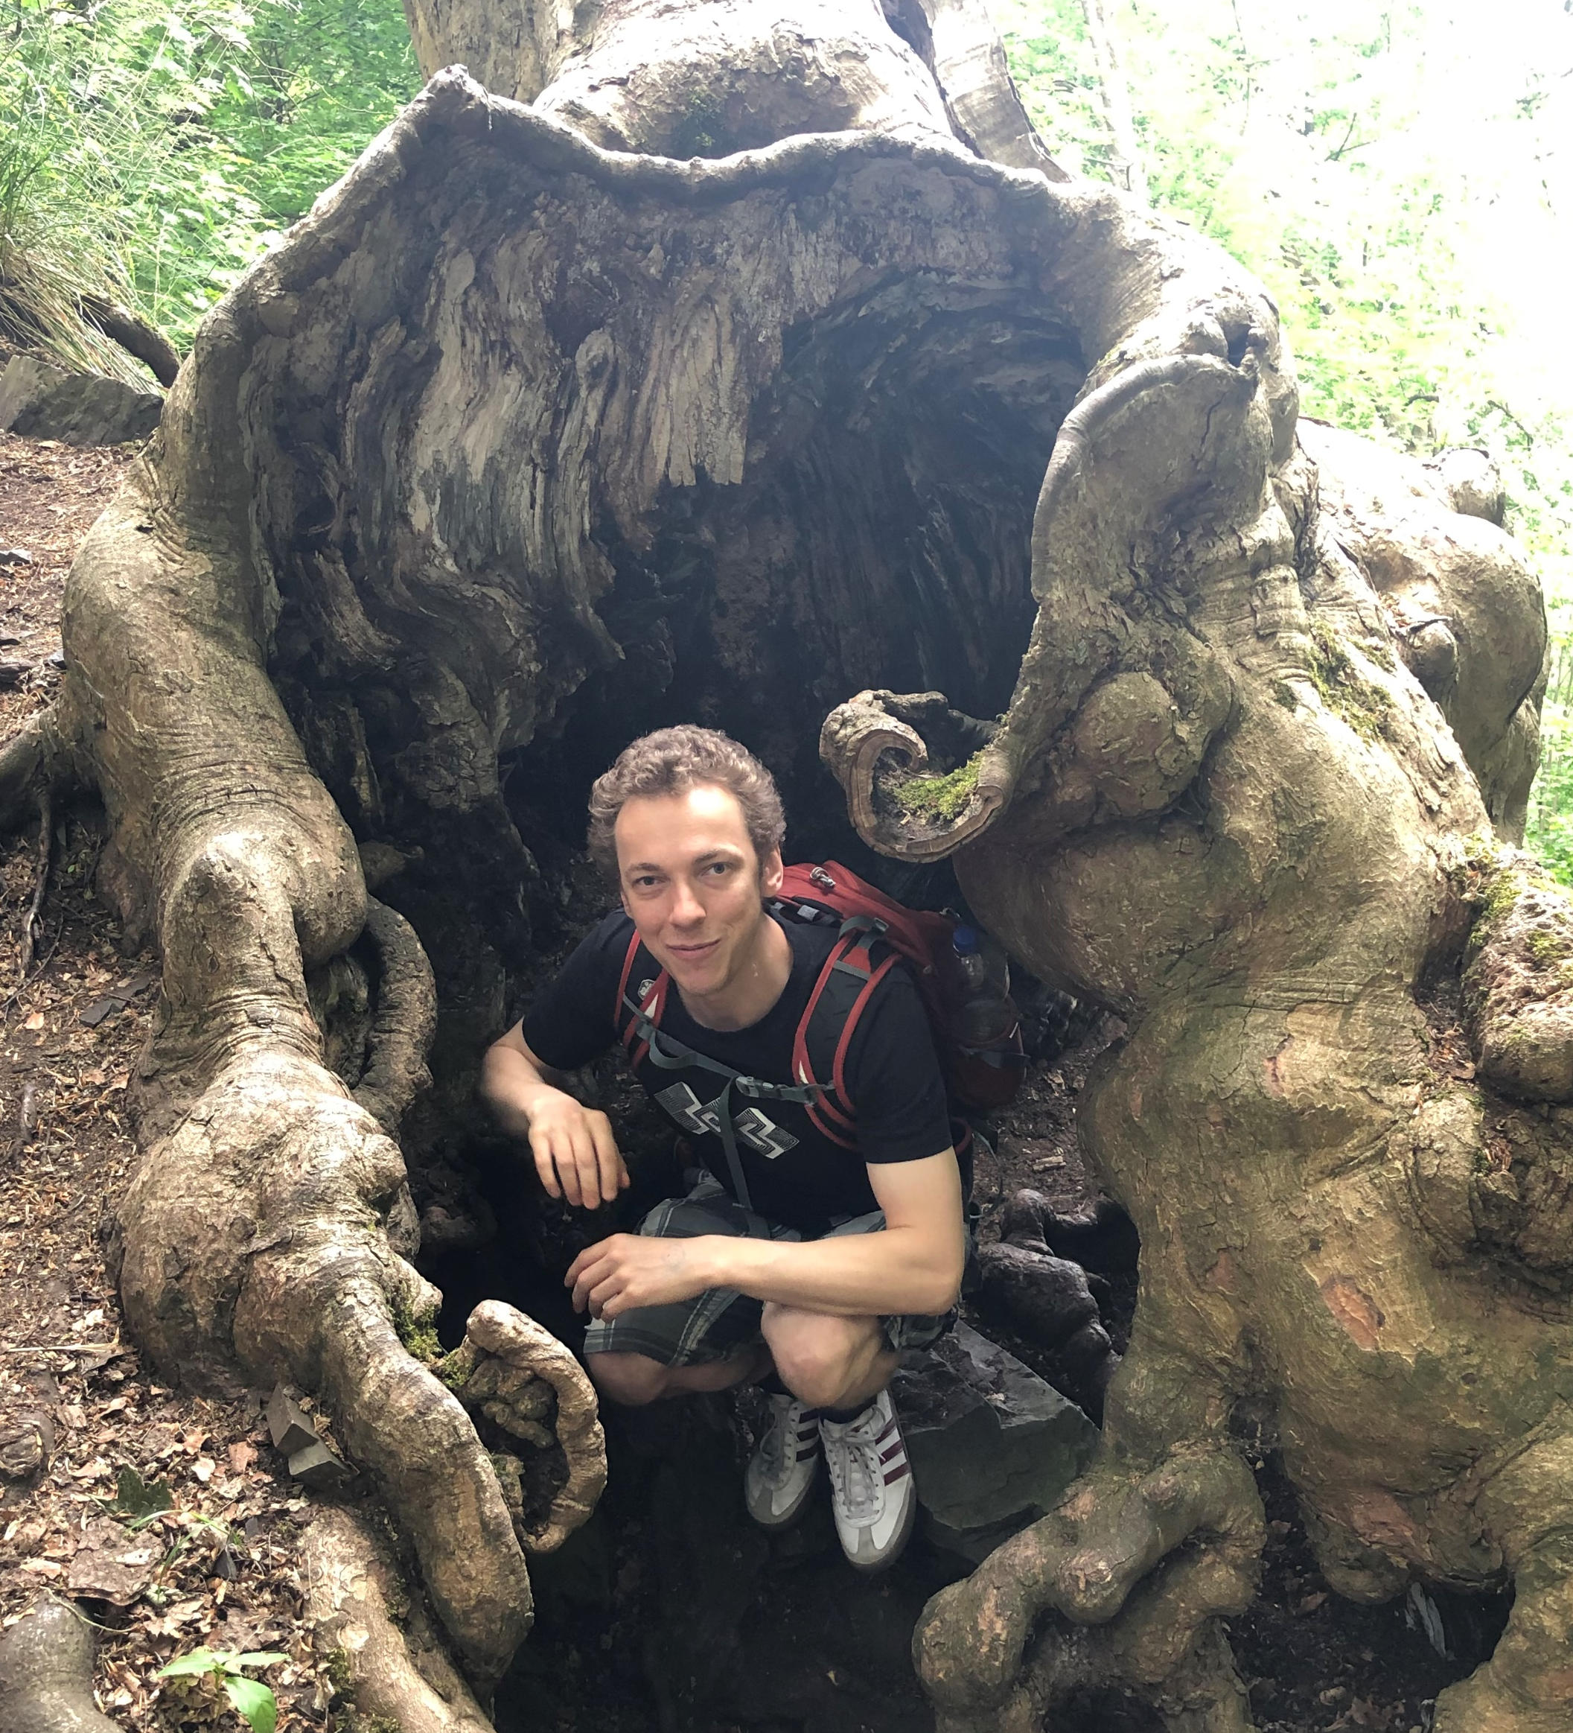
About me
B.Sc. Natural Language Processing
Studying M.Sc. Informatics (50%) since 2018
Also did lots of NLP for my IDP and practical courses.
Senior Developer for Navigation Data Standard
Work on 3D HD map rendering and modeling.
I would like to bring HD Maps and Differentiable Rendering into my Master’s thesis ☺
Figure 1: Joseph in his natural habitat.
24.06.2022
Initial Master’s Thesis Topic Presentation
Joseph Birkner
2
Notes:
2

Slide 3
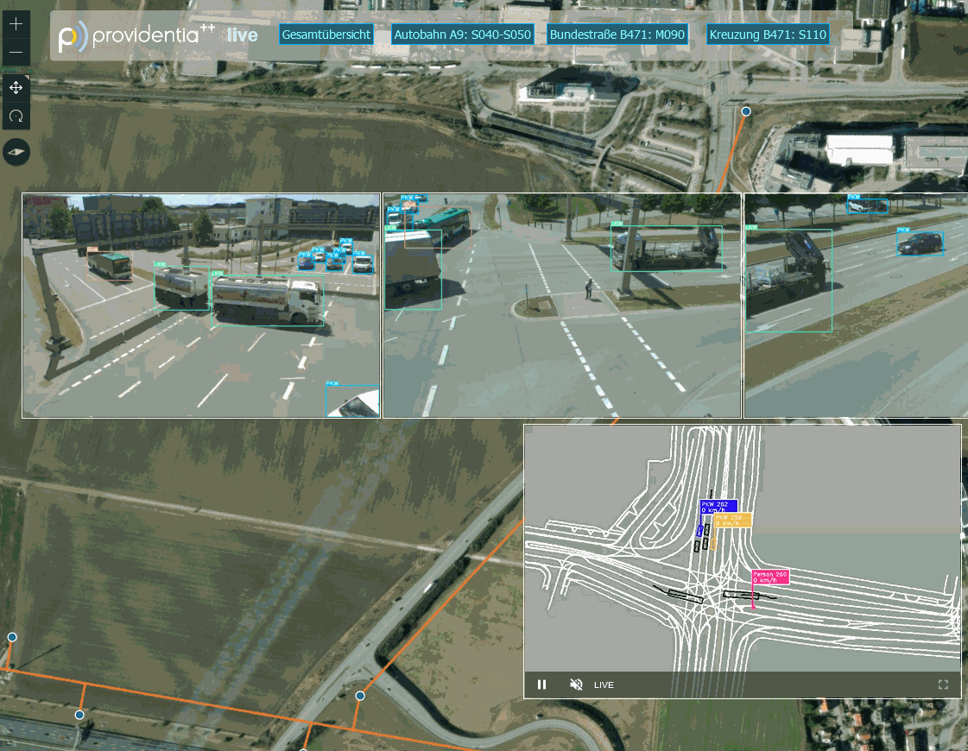
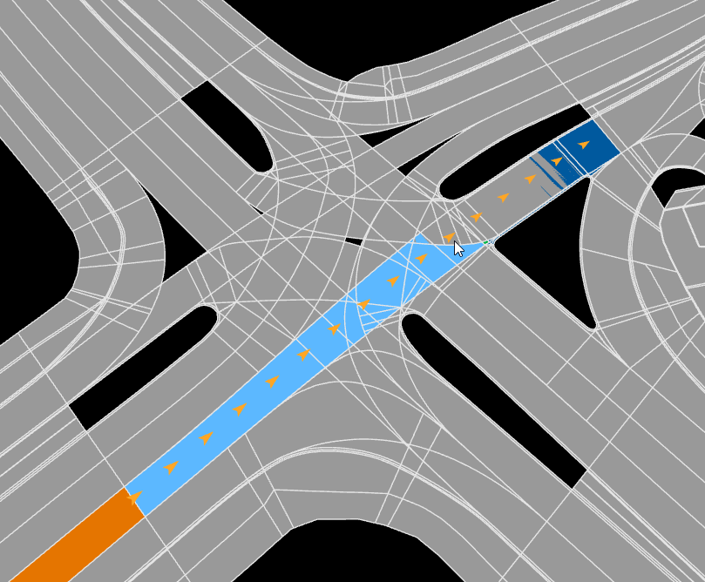
Monocular 3D Detection in Providentia++
Figure 2: Live views of RGB cameras from the B471:S110 intersection
Figure 3: OpenDRIVE map of the same intersection
24.06.2022
Initial Master’s Thesis Topic Presentation
Joseph Birkner
3
Notes:
3

Slide 4
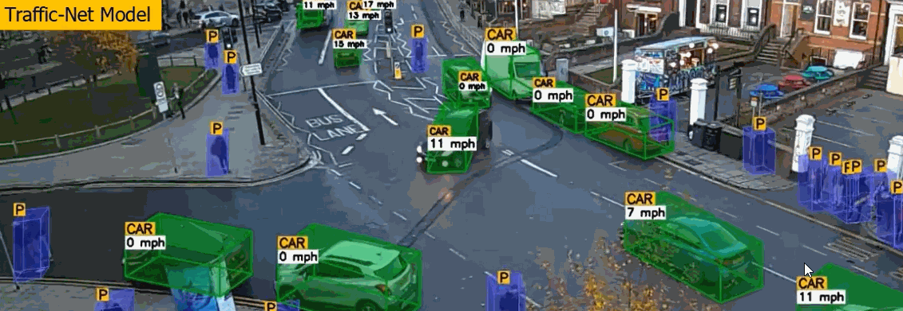
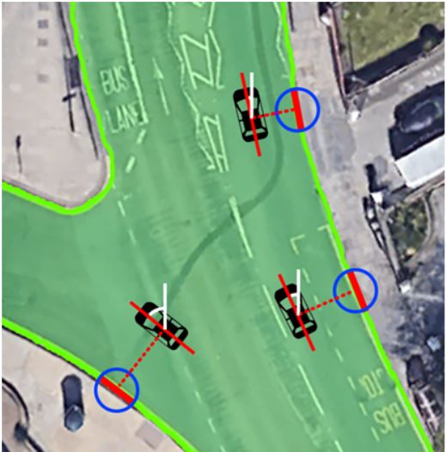
Maps as an Auxiliary Feature (1)
Traffic-Net: 3D Traffic Monitoring Using a Single Camera (Sep 21)
Strong prior knowledge on object width/height used to estimate 3D BBs
Effective use of Kalman filters for trajectory/heading estimation
Parts of Figure 1 and 3 in the Traffic-Net Paper
24.06.2022
Initial Master’s Thesis Topic Presentation
Joseph Birkner
4
Notes:
4

Slide 5
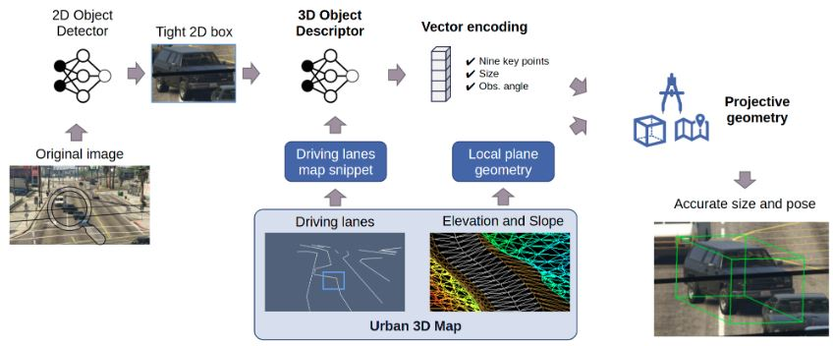
Maps as an Auxiliary Feature (2)
UrbanNet: Leveraging Urban Maps for Long Range 3D Object Detection (Oct 21)
Bounding Box estimation network supervised using data from GTA V ☺
Figure 2 from UrbanNet
24.06.2022
Initial Master’s Thesis Topic Presentation
Joseph Birkner
5
Notes:
5

Slide 6
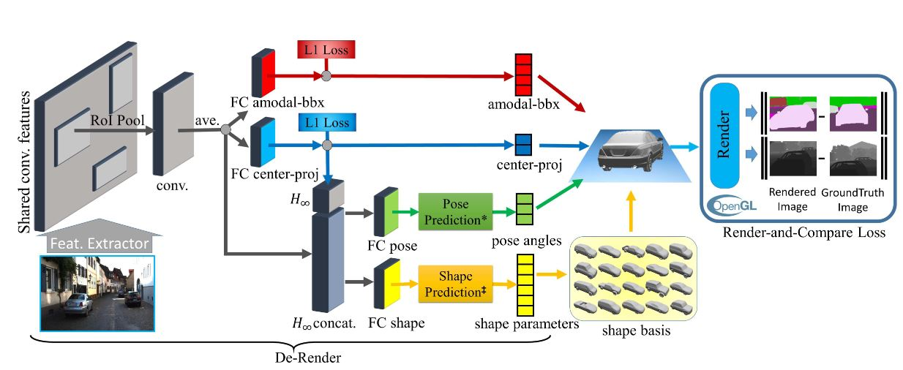
Neural Rendering
3D-RCNN: Instance-level 3D Object Reconstruction via Render-and-Compare (CVPR 2018)
Could also predict heading and velocity change on top of x/y/theta/w/h/d/category
Could pixel-wise lane orientation annotations help?
Self-supervision by differentiable rendering of the NNs proposed object labels and comparing with (some channel of) the input image.
Figure 1 from 3D-RCNN
24.06.2022
Initial Master’s Thesis Topic Presentation
Joseph Birkner
6
Notes:
6

Slide 7
References (so far)
Rezaei, Mahdi, Mohsen Azarmi, and Farzam Mohammad Pour Mir. "Traffic-Net: 3D Traffic Monitoring Using a Single Camera." arXiv preprint arXiv:2109.09165 (2021).
Mouawad, Issa, et al. "Time-to-Label: Temporal Consistency for Self-Supervised Monocular 3D Object Detection." arXiv preprint arXiv:2203.02193 (2022).
Marinello, Nicola, Marc Proesmans, and Luc Van Gool. "TripletTrack: 3D Object Tracking Using Triplet Embeddings and LSTM." Proceedings of the IEEE/CVF Conference on Computer Vision and Pattern Recognition. 2022.
Heylen, Jonas, et al. "MonoCInIS: Camera Independent Monocular 3D Object Detection using Instance Segmentation." Proceedings of the IEEE/CVF International Conference on Computer Vision. 2021.
24.06.2022
Initial Master’s Thesis Topic Presentation
Joseph Birkner
7
Notes:
7

Slide 8
References (so far)
Carrillo, Juan, and Steven Waslander. "Urbannet: Leveraging urban maps for long range 3d object detection." 2021 IEEE International Intelligent Transportation Systems Conference (ITSC). IEEE, 2021.
Ye, Xiaoqing, et al. "Rope3D: The Roadside Perception Dataset for Autonomous Driving and Monocular 3D Object Detection Task." Proceedings of the IEEE/CVF Conference on Computer Vision and Pattern Recognition. 2022.
Li, Peixuan, and Jieyu Jin. "Time3D: End-to-End Joint Monocular 3D Object Detection and Tracking for Autonomous Driving." Proceedings of the IEEE/CVF Conference on Computer Vision and Pattern Recognition. 2022.
24.06.2022
Initial Master’s Thesis Topic Presentation
Joseph Birkner
8
Notes:
8

